Slide 1

Mind the GAP
A 360 degree view of the Galaxy with the K2 Galactic Archaeology Program
Kepler & K2 Science Conference IV
20 June 2017
Joel C. Zinn
Ohio State University
with D. Stello, M. H. Pinsonneault, D. Huber
and Aldo Serenelli, Keivan Stassun, Jamie Tayar, & Fabienne Bastien
@joelczinn

Slide 2
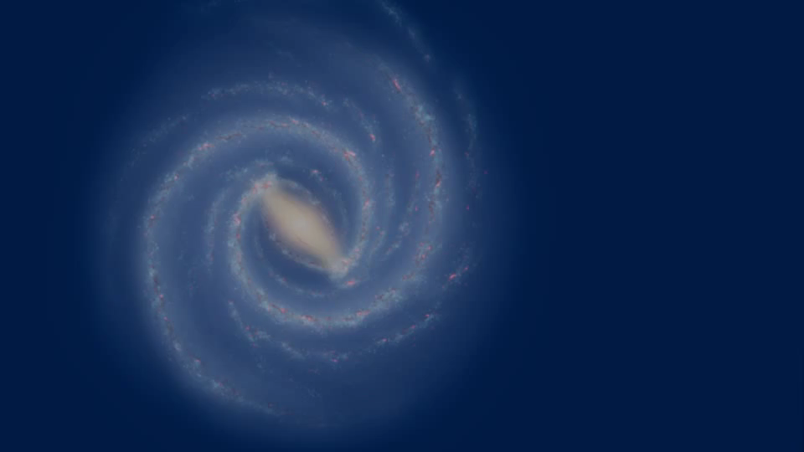
Why use K2 for galactic archaeology?
K2 Galactic Archaeology Program
Joel C. Zinn
Notes:
K2 offers views of diverse stellar environments — metallicity, bulge, halo, disc
this shows campaigns 1-8, but 1-10 have data, 11-14 have target lists and 15 and 16 are planned.
Red giant oscillators give precise (10%) ages, masses (10%), and radii (5%)
Galactic archaeology!

Slide 3



Asteroseismology primer
K2 Galactic Archaeology Program
Joel C. Zinn
Notes:
Handberg, with all Quarters
depending on how well can measure numax, can get very precise logg:
\mathrm{Relative\ flux}\ [ppm].

Slide 4
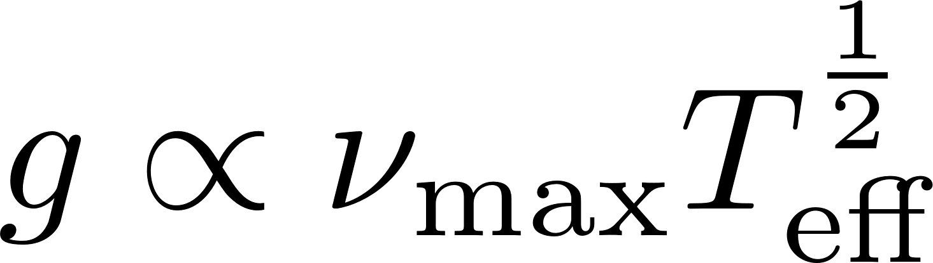
Asteroseismology primer
K2 Galactic Archaeology Program
Joel C. Zinn
Notes:
Handberg, with all Quarters
depending on how well can measure numax, can get very precise logg:
\mathrm{Relative\ flux}\ [ppm].

Slide 5


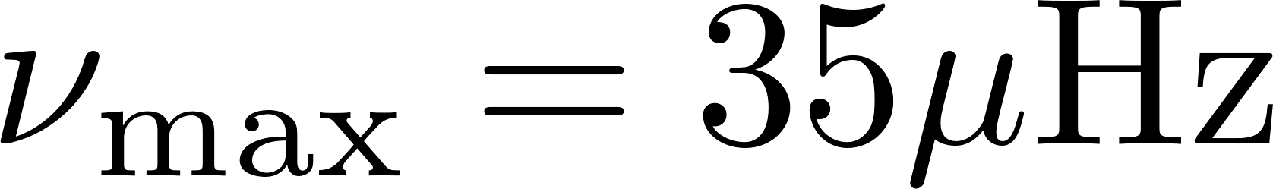
Asteroseismic gravities: K2
oscillations
granulation
K2 Galactic Archaeology Program
Joel C. Zinn
Notes:
this is what a typical K2 star looks like — a red clump star.
numax is related to surface gravity (Brown et al. 1991; Kjeldsen & Bedding 1995)
g \propto \nu_{\mathrm{max}} T_{\mathrm{eff}}^{\frac{1}{2}}
\nu_{\mathrm{max}} = 35 \mu \mathrm{Hz}
\log g = 2.46
T_{\mathrm{eff}} = 4700 \mathrm{K}
but these spectra show more than just oscillations…

Slide 6
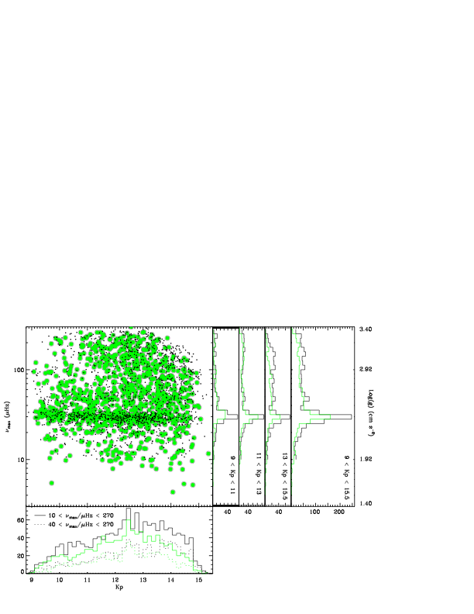



K2 GAP DR 1
log g ~ 1.8
K2 Galactic Archaeology Program
Stello, Zinn+ 2017
Joel C. Zinn
Notes:
complete between 40 and 270 muhz
1200 confirmed oscillators out of 8600
Data Release 1 (Stello, Zinn, et al. 2017): ~1200 stars
see Chaplin+ 2011 for predicting whether or not something is observable.

Slide 7
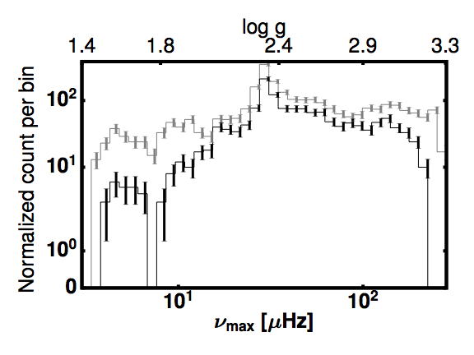
K2 GAP DR 2: BAM
intrinsic
Count per bin
recovered
K2 Galactic Archaeology Program
Zinn+, in prep.
Joel C. Zinn
Notes:
BAM

Slide 8
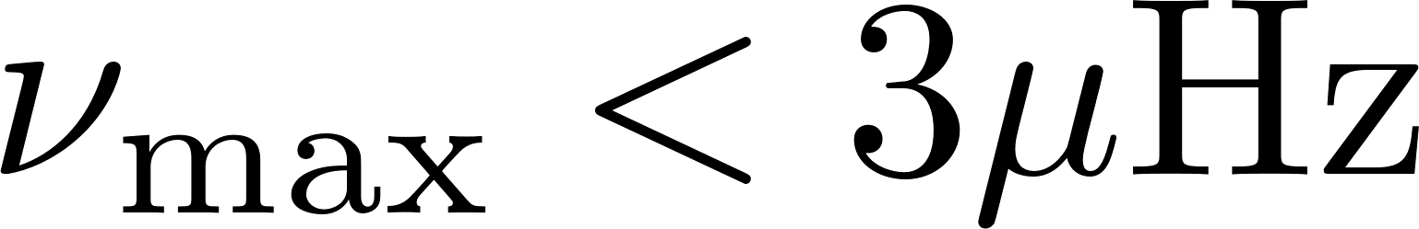
Surface gravities for
log g <1.8
K2 Galactic Archaeology Program
Zinn+, in prep.
Joel C. Zinn
Notes:
SO WHAT CAN WE DO: GRAN
it appears like a non-detection

Slide 9
Surface gravities for
log g <1.8
K2 Galactic Archaeology Program
Zinn+, in prep.
Joel C. Zinn
Notes:
it appears like a non-detection

Slide 10
Surface gravities for
log g <1.8
oscillations
granulation
K2 Galactic Archaeology Program
Zinn+, in prep.
Joel C. Zinn
Notes:
it appears like a non-detection

Slide 11
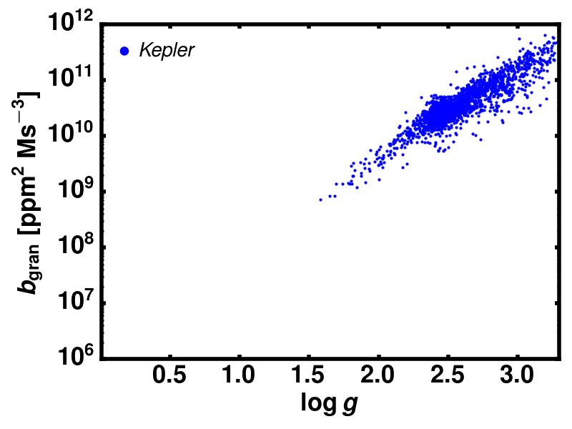
Granulation gravity
Similar to ‘Flicker’ gravity (Bastien+ 2013)
Granulation gravity uses information from entire power spectrum
granulation amplitude
K2 Galactic Archaeology Program
Zinn+, in prep.
Joel C. Zinn
Notes:
sources of systematic error in measurement:
“various technical reasons to believe we can do better”
put blue/red spectro/seismic gravity
high-pass filtering — some is necessary because BAM does not account for low-frequency activity; but if too much, then granulation is filtered out.
error in relation (slope and intercept) is less than 1 per cent.

Slide 12
APOGEE spectroscopic gravity calibrators
difference in log g
K2 Galactic Archaeology Program
Zinn+, in prep.
Joel C. Zinn
Notes:
Ricardo Schiavon APOGEE
2 in 6791 and 1 in 6819
put DEVIATION on y-axis label
put CIRCLE for calibrator

Slide 13
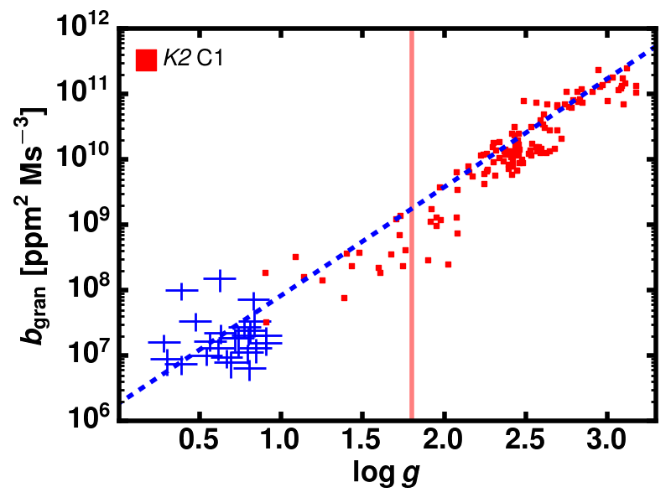
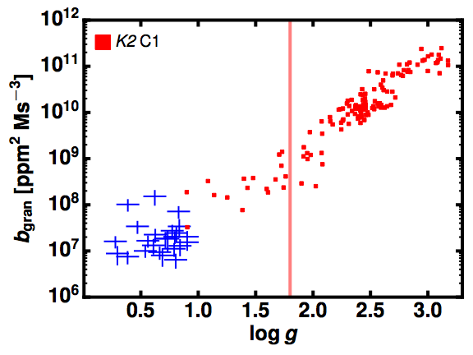
Granulation gravity
Information from entire power spectrum
0.1 dex precision down to ~ log g 0.4
asteroseismology
granulation amplitude
granulation
K2 Galactic Archaeology Program
Zinn+, in prep.
Joel C. Zinn
Notes:
PUT LABELS: “SEISMIC LIMIT” and “OUR DATA”
seismic data on top, and the granulation data on the bottom.
GALAXIA MODEL WITH CUTOFF OF 1.8 and WITHOUT
sources of systematic error in measurement:
“various technical reasons to believe we can do better”
put blue/red spectro/seismic gravity
high-pass filtering — some is necessary because BAM does not account for low-frequency activity; but if too much, then granulation is filtered out.
error in relation (slope and intercept) is less than 1 per cent.

Slide 14
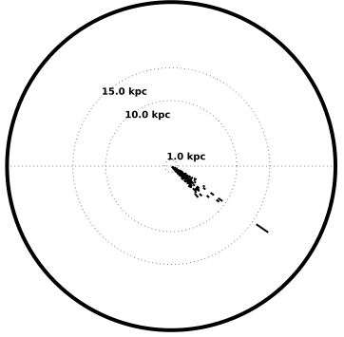
Halo stars in K2 with asteroseismic gravity
C6
asteroseismology
Galactic
center
K2 Galactic Archaeology Program
Zinn+, in prep.
Joel C. Zinn
Notes:
comparable to SEGUE distance precisions
“ASTEROSEISMIC: LOCAL”; “GRANULATION: GLOBAL”
C7: toward Galactic center (Sagittarius)
C6 : near Virgo, well above plane
C4 : near Taurs, anti-center
C1 : near Virgo, nearly perfectly out of plane

Slide 15
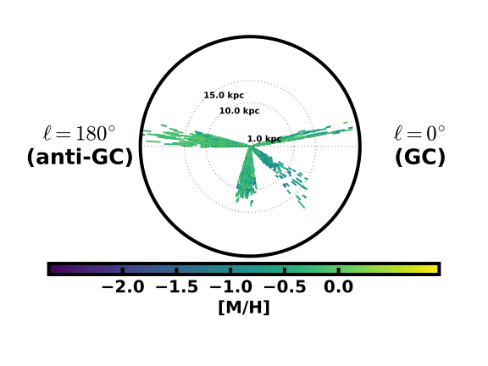
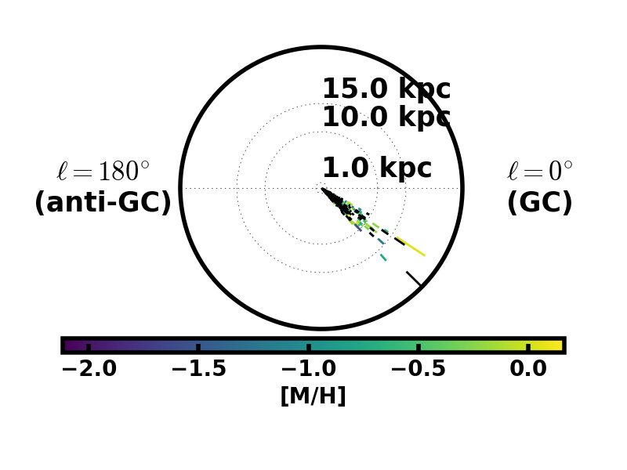
Halo stars in K2 with granulation gravity
DR1 (C1) + DR2 (C4, C6, C7)
Probe halo out to 30kpc
Distance precision of ~20%
asteroseismology
Galactic
center
granulation
K2 Galactic Archaeology Program
Zinn+, in prep.
Joel C. Zinn
Notes:
comparable to SEGUE distance precisions
“ASTEROSEISMIC: LOCAL”; “GRANULATION: GLOBAL”
C7: toward Galactic center (Sagittarius)
C6 : near Virgo, well above plane
C4 : near Taurs, anti-center
C1 : near Virgo, nearly perfectly out of plane

Slide 16
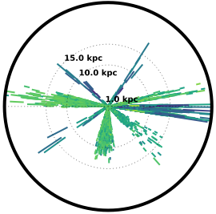
Halo stars in K2 with granulation gravity
DR1 (C1) + DR2 (C4, C6, C7)
+ Galaxia C2, C3, C5, C8
Probe halo out to 30kpc
Distance precision of ~20%
asteroseismology
Galactic
center
granulation
K2 Galactic Archaeology Program
Zinn+, in prep.
Joel C. Zinn
Notes:
comparable to SEGUE distance precisions
“ASTEROSEISMIC: LOCAL”; “GRANULATION: GLOBAL”
C7: toward Galactic center (Sagittarius)
C6 : near Virgo, well above plane
C4 : near Taurs, anti-center
C1 : near Virgo, nearly perfectly out of plane

Slide 17
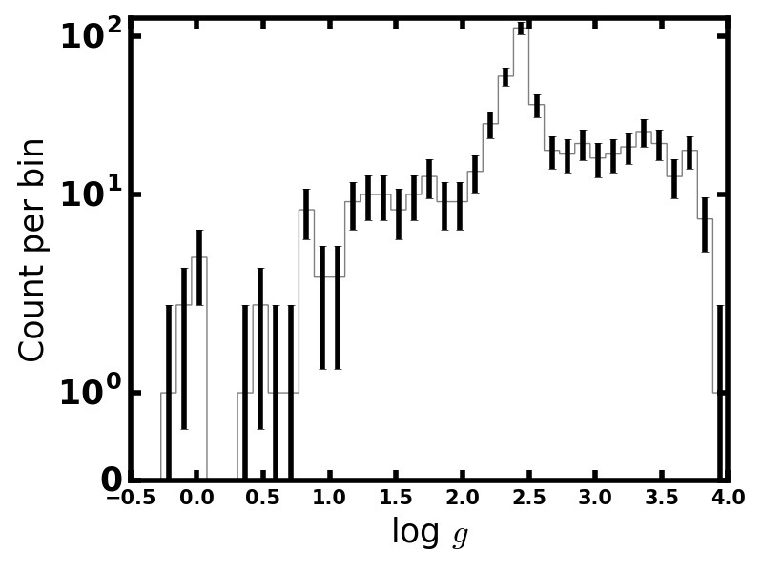
Looking forward to…
Granulation surface gravities good to 0.1 dex for halo stars: down to log g ~ 1.0 in K2 and log g ~ 0.4 in Kepler
Gaia: parallax radius + gravity -> mass
TESS: ~250k luminous stars otherwise without asteroseismic surface gravities
~7000 K2GAP red giants with asteroseismic gravities (C1, C4, C6, C7) +500 more with granulation gravities
Kepler
K2
granulation
asteroseismology
K2 Galactic Archaeology Program
Joel C. Zinn
Notes:
can improve on method… light curve systematics
continuous viewing zone red giants
asteroseismology will out-perform Gaia on distances for greater than 5kpc

Slide 19


Surface gravities for
log g <1.8
granulation amplitude, “b”
K2 Galactic Archaeology Program
Zinn+, in prep.
Joel C. Zinn
Notes:
*** SIMILAR TO FLICKER ***

Slide 20
Kepler
K2
granulation
asteroseismology
K2 Galactic Archaeology Program
Joel C. Zinn

Slide 21
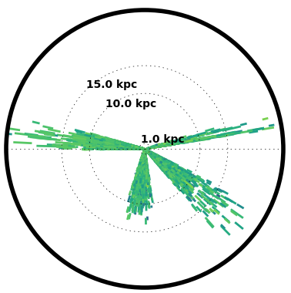
Halo stars in K2 with granulation gravity
DR1 (C1) + DR2 (C4, C6, C7)
Probe halo out to 30kpc
Distance precision of ~20%
asteroseismology
Galactic
center
granulation
K2 Galactic Archaeology Program
Zinn+, in prep.
Joel C. Zinn
Notes:
comparable to SEGUE distance precisions
“ASTEROSEISMIC: LOCAL”; “GRANULATION: GLOBAL”
C7: toward Galactic center (Sagittarius)
C6 : near Virgo, well above plane
C4 : near Taurs, anti-center
C1 : near Virgo, nearly perfectly out of plane

Slide 22
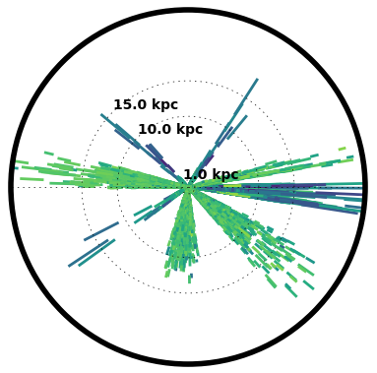
Halo stars in K2 with granulation gravity
DR1 (C1) + DR2 (C4, C6, C7)
+ Galaxia C2, C3, C5, C8
Probe halo out to 30kpc
Distance precision of ~20%
asteroseismology
Galactic
center
granulation
K2 Galactic Archaeology Program
Zinn+, in prep.
Joel C. Zinn
Notes:
comparable to SEGUE distance precisions
“ASTEROSEISMIC: LOCAL”; “GRANULATION: GLOBAL”
C7: toward Galactic center (Sagittarius)
C6 : near Virgo, well above plane
C4 : near Taurs, anti-center
C1 : near Virgo, nearly perfectly out of plane

Slide 23
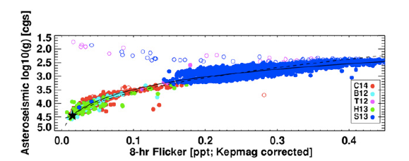
‘Flicker’ Gravity
Granulation power on time-scales of 8 hours and less
25% precision down to ~ log g of 2.5
Bastien+ 2016
Notes:
Tuckers out below log g 2.5 — at red clump gravities and below. so all giants more luminous than this are missed
this is because the red clump oscillation modes enter in at about 8 hours
spread in flicker — log g relation near clump for the same reason

Slide 24
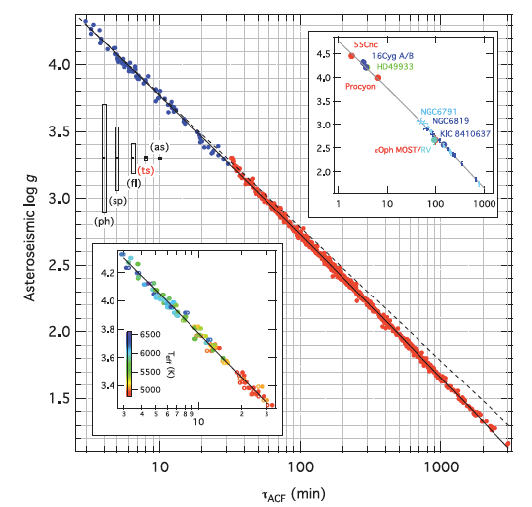
Convective timescale gravity
Time-scale of convective motions
4% precision down to ~ log g of 1
Kallinger+ 2016
Kallinger+ 2016
Notes:
“relies on already knowing the answer”
higher cadence won’t help of course — it is the baseline of the time series that will determine how well you can resolve the modes of high-luminosity giants.

Slide 25
K2 Galactic Archaeology Program
Zinn+, in prep.
Joel C. Zinn

Slide 26
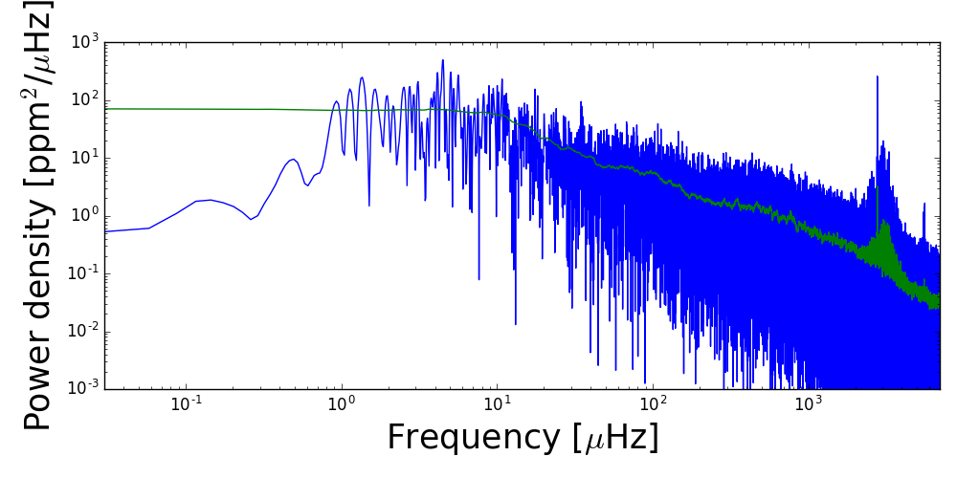
Best case scenario: the Sun
K2 Galactic Archaeology Program
Zinn+, in prep.
Joel C. Zinn
Notes:
VIRGO

Slide 27
Zinn+, in prep.

Slide 28
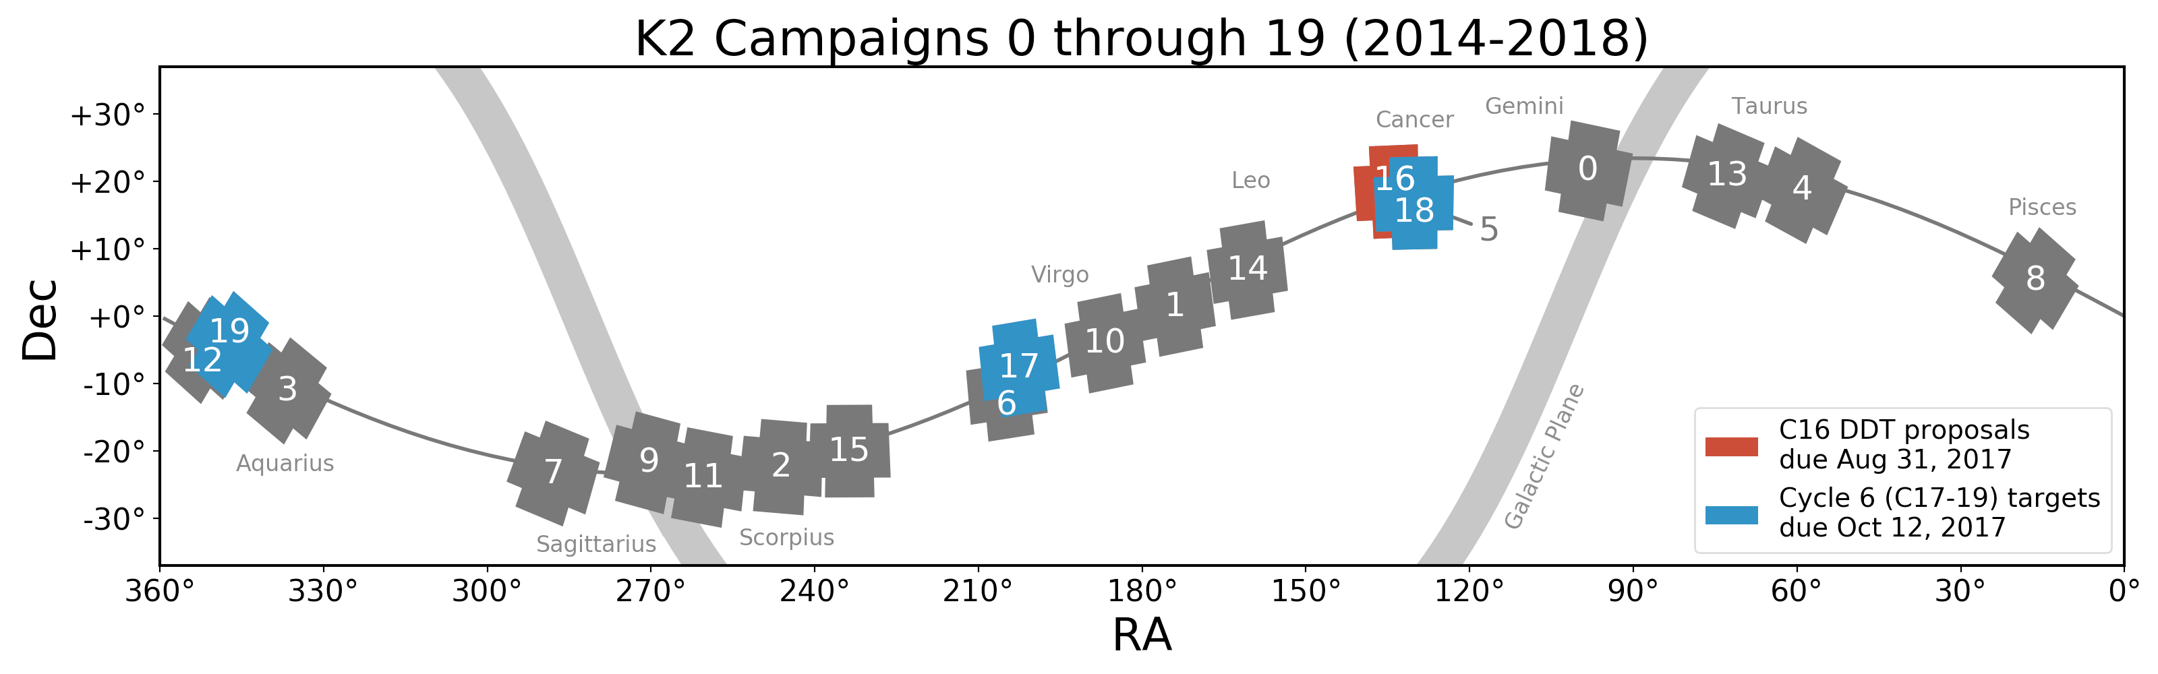
NASA

Slide 29
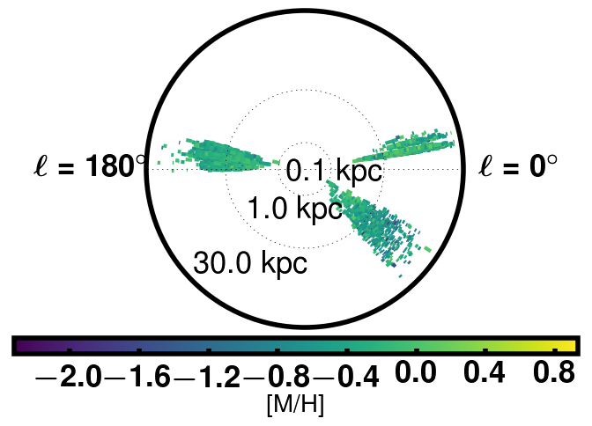
K2 Galactic Archaeology Program
Zinn+, in prep.
Joel C. Zinn

Slide 31
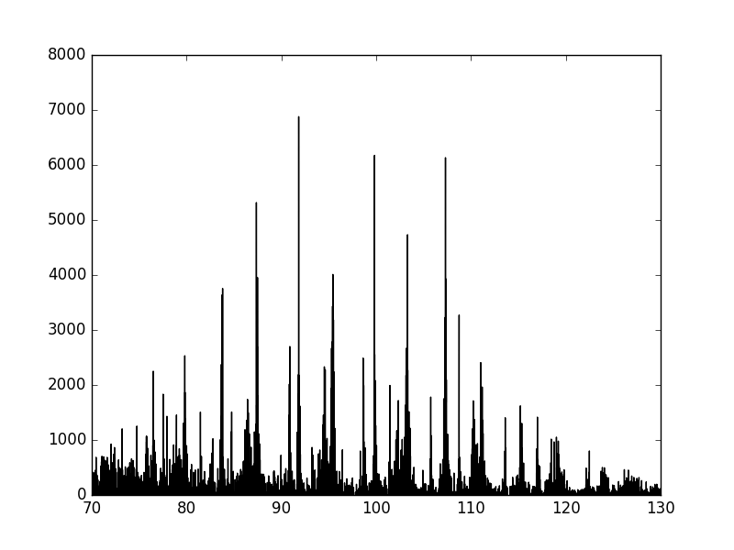
Asteroseismology primer
K2 Galactic Archaeology Program
Joel C. Zinn
Notes:
depending on how well can measure numax, can get very precise logg:
\mathrm{Relative\ flux}\ [ppm].

